Slide 1
Unit 13 – Tour Operations
P2 - Describe the products and services provided by different categories of tour operator for different target markets
Notes:
1

Slide 2
Connector
Watch the following video.
What type of customers do you think would book a holiday with Kuoni?
What types of destinations do they provide holidays to?
Do you think they would be expensive or cheap holidays?
http://www.youtube.com/watch?v=72tTB_397Ro
Notes:
2

Slide 3
Big Picture
You will be learning about the five different types of tour operator.
You will be looking at the components of package holidays.
You will understand what types of customer choose the different types of tour operator.

Slide 4
Outcomes
ALL will be able to complete P2

Slide 5
Tour operator categories
Outbound
Inbound
Domestic
Specialist
Mass market

Slide 6
Products and services
Package holiday – a holiday including at least two elements of transport, accommodation and other services, for example the services of an overseas representative

Slide 7
Components of a standard package
Most package holidays are pre-arranged and presented in brochures by tour operators. Customers can visit travel agents to get brochures or call the tour operator directly. The brochure is an important sales tool for the package holiday. Because of the intense competition in the holiday industry tour operators constantly review their products and introduce new packages.
What does a package holiday have to include under Package Travel Regulations?
http://www.virginholidays.co.uk/brochures/sandals/holidays/the_caribbean/antigua/sandals_grande_antigua_resort__spa/#

Slide 8
Tailor made
A Tailor-made package is dynamically packaged. The different elements of the package are specifically selected to meet the needs of a particular customer. Tour operators are offering tailor made services more frequently as experienced travellers do not appreciate the mass market approach.
People have higher expectations in terms of product and customer service.

Slide 9
Range of destinations
Finding new destinations is part of product development for a tour operator. As people take more frequent holidays and become more experienced travellers there is an increasing demand to visit new places.

Slide 10
Accommodation choices
Offering different types of accommodation is another means of offering a differentiated product to customers. Tourists expect to be able to choose between different types of accommodation such as villas, hotels and camping. They are also used to choosing board type.

Slide 12
Transport options
Tour operators offer different transport options depending on what customers want. Examples include train journeys or first class travel.

Slide 13
Ancillary products and services
Tour operators have become very sophisticated in the extra services that they can offer a tourist, usually at an additional cost. For example:
Holiday insurance
Airport car parking
Airport Hotel
Airport lounge
Late check out from room
Upgrades in room
Kids clubs

Slide 14
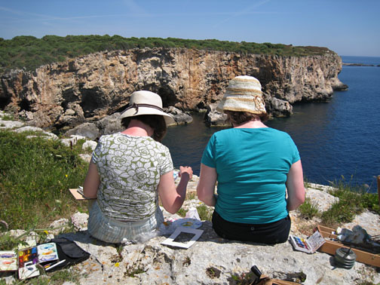
Target market
Families
Couples
Solo travellers
Specific age groups
Special interests
People with specific needs

Slide 15
P2
You should select one tour operator from each of the categories, identify their target market(s) and provide a review of the products and services they offer.
Outbound - Kuoni
Inbound - Discover Travel and Tours
Domestic – Shearings Holidays
Specialist – Tucan Travel
Mass market - Thomson

Slide 16
M2
Analyse how a selected tour operator’s portfolio of products and services meet the needs of its target market(s)
You must demonstrate a sound understanding of what the customers needs are and how they are met by the current range of products and services. You should select your tour operator carefully to facilitate the achievement of both M2 and D2

Slide 17
D2
D2 recommend, with justification, how a selected tour operator could expand its range of products and services for its current target market or adapt its range of products and services to appeal to a new market.

Slide 18
D2
You must review the product range and make recommendations for how it could be expanded to widen its appeal to the tour operator’s existing target market or adapted to widen its appeal to a new target market.
Recommendations must be supported by a clear rationale and justification.
Examples might be to add new destinations that would appeal to the current target market and complement existing destinations or to branch out to take advantage of recent trends and attract new target groups, for example extreme sports.

